Slide 1
Bellissima DMS
A brief introduction

Slide 2
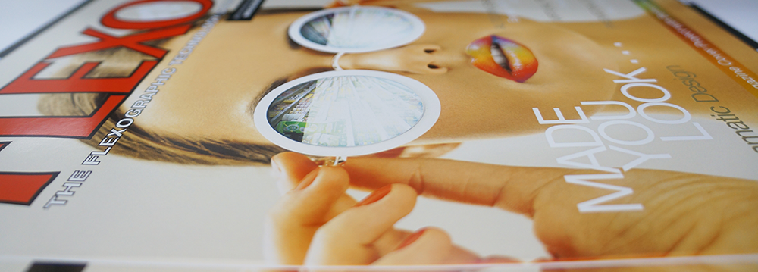
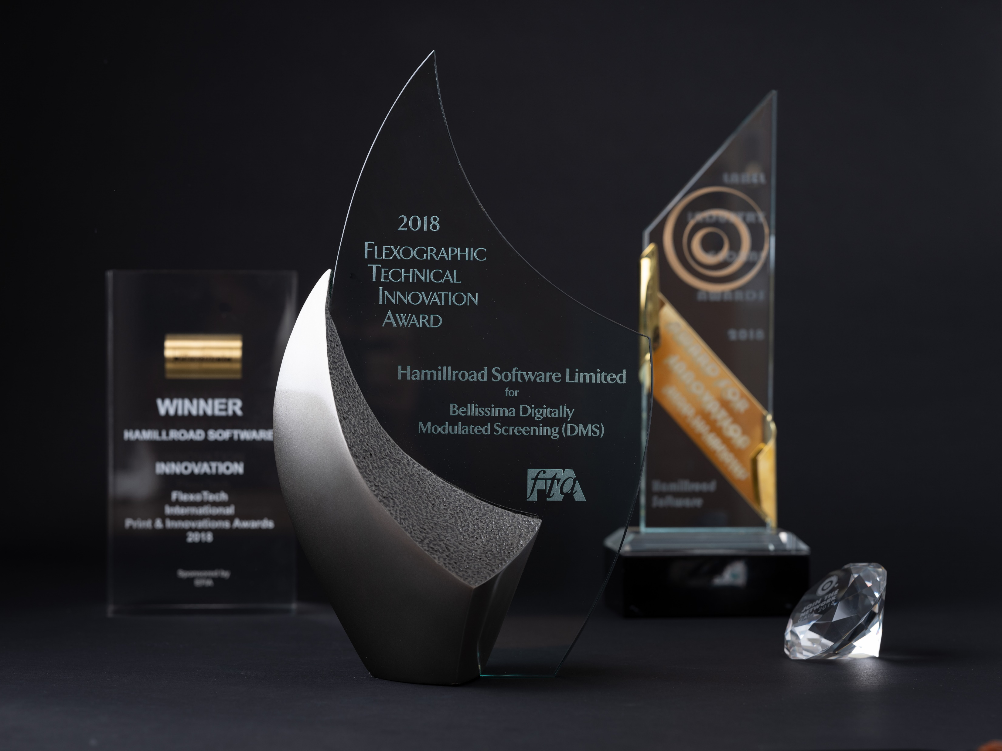
Hamillroad Software & Bellissima DMS
UK based software company with offices in North America
>20 years developing prepress products
Screening solutions that reduce costs & increase productivity
Patent protected technology
Multi award-winning innovation
“Bellissima is our biggest point of difference, helping us achieve unbelievable growth”
Mark Cook, CEO, Catapult Print, USA.
Flexographic Technical Association Innovation Award 2018

Slide 3
What is Bellissima DMS
While Bellissima exhibits some characteristics of ‘stochastic’ technology – particularly high fidelity printing,
It is not an FM screen.
While Bellissima is stable on press like traditional screens,
It is not an AM screen.
While Bellissima delivers both exceptional highlights and shadow detail simultaneously,
It is not a Hybrid Screen.
While Bellissima delivers ink saving like some existing screening technologies
It is not based on Concentric or FM screening.
Bellissima DMS is a patented new screening technology
with the best characteristics of existing screens, while avoiding their problems
CS/FM
INK SAVINGS
DM
AM
ON PRESS
STABILITY
FM
HIGH
FIDELITY

Slide 4
Bellissima is… Intelligent Screening for Flexo
Algorithmic screening
Precise dot placement
Controlled dot spacing
Controlled dot size

Slide 5
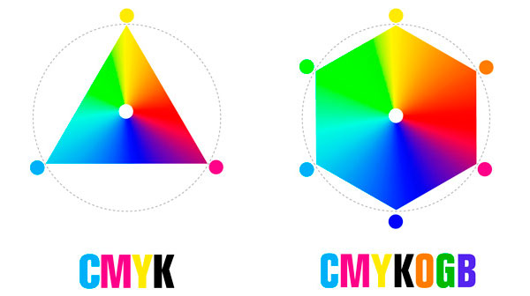
What does Bellissima DMS offer?
Less Ink
Reduced Waste
Greater Productivity
Increased Capacity
Lower CAPEX
COSTS
FIDELITY
Conventional
AM/XM screen
175 lpi (actual)
Bellissima DMS Standard screen
300 – 400 lpi (equivalent)
Bellissima DMS
eXtended screen
350 – 450 lpi (equivalent)

Slide 6
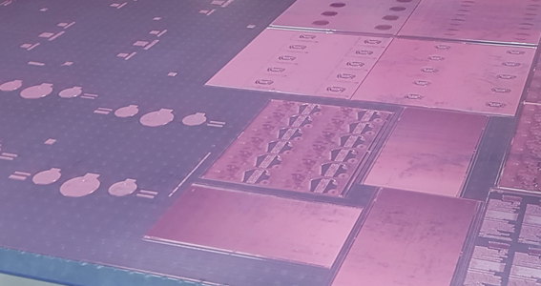
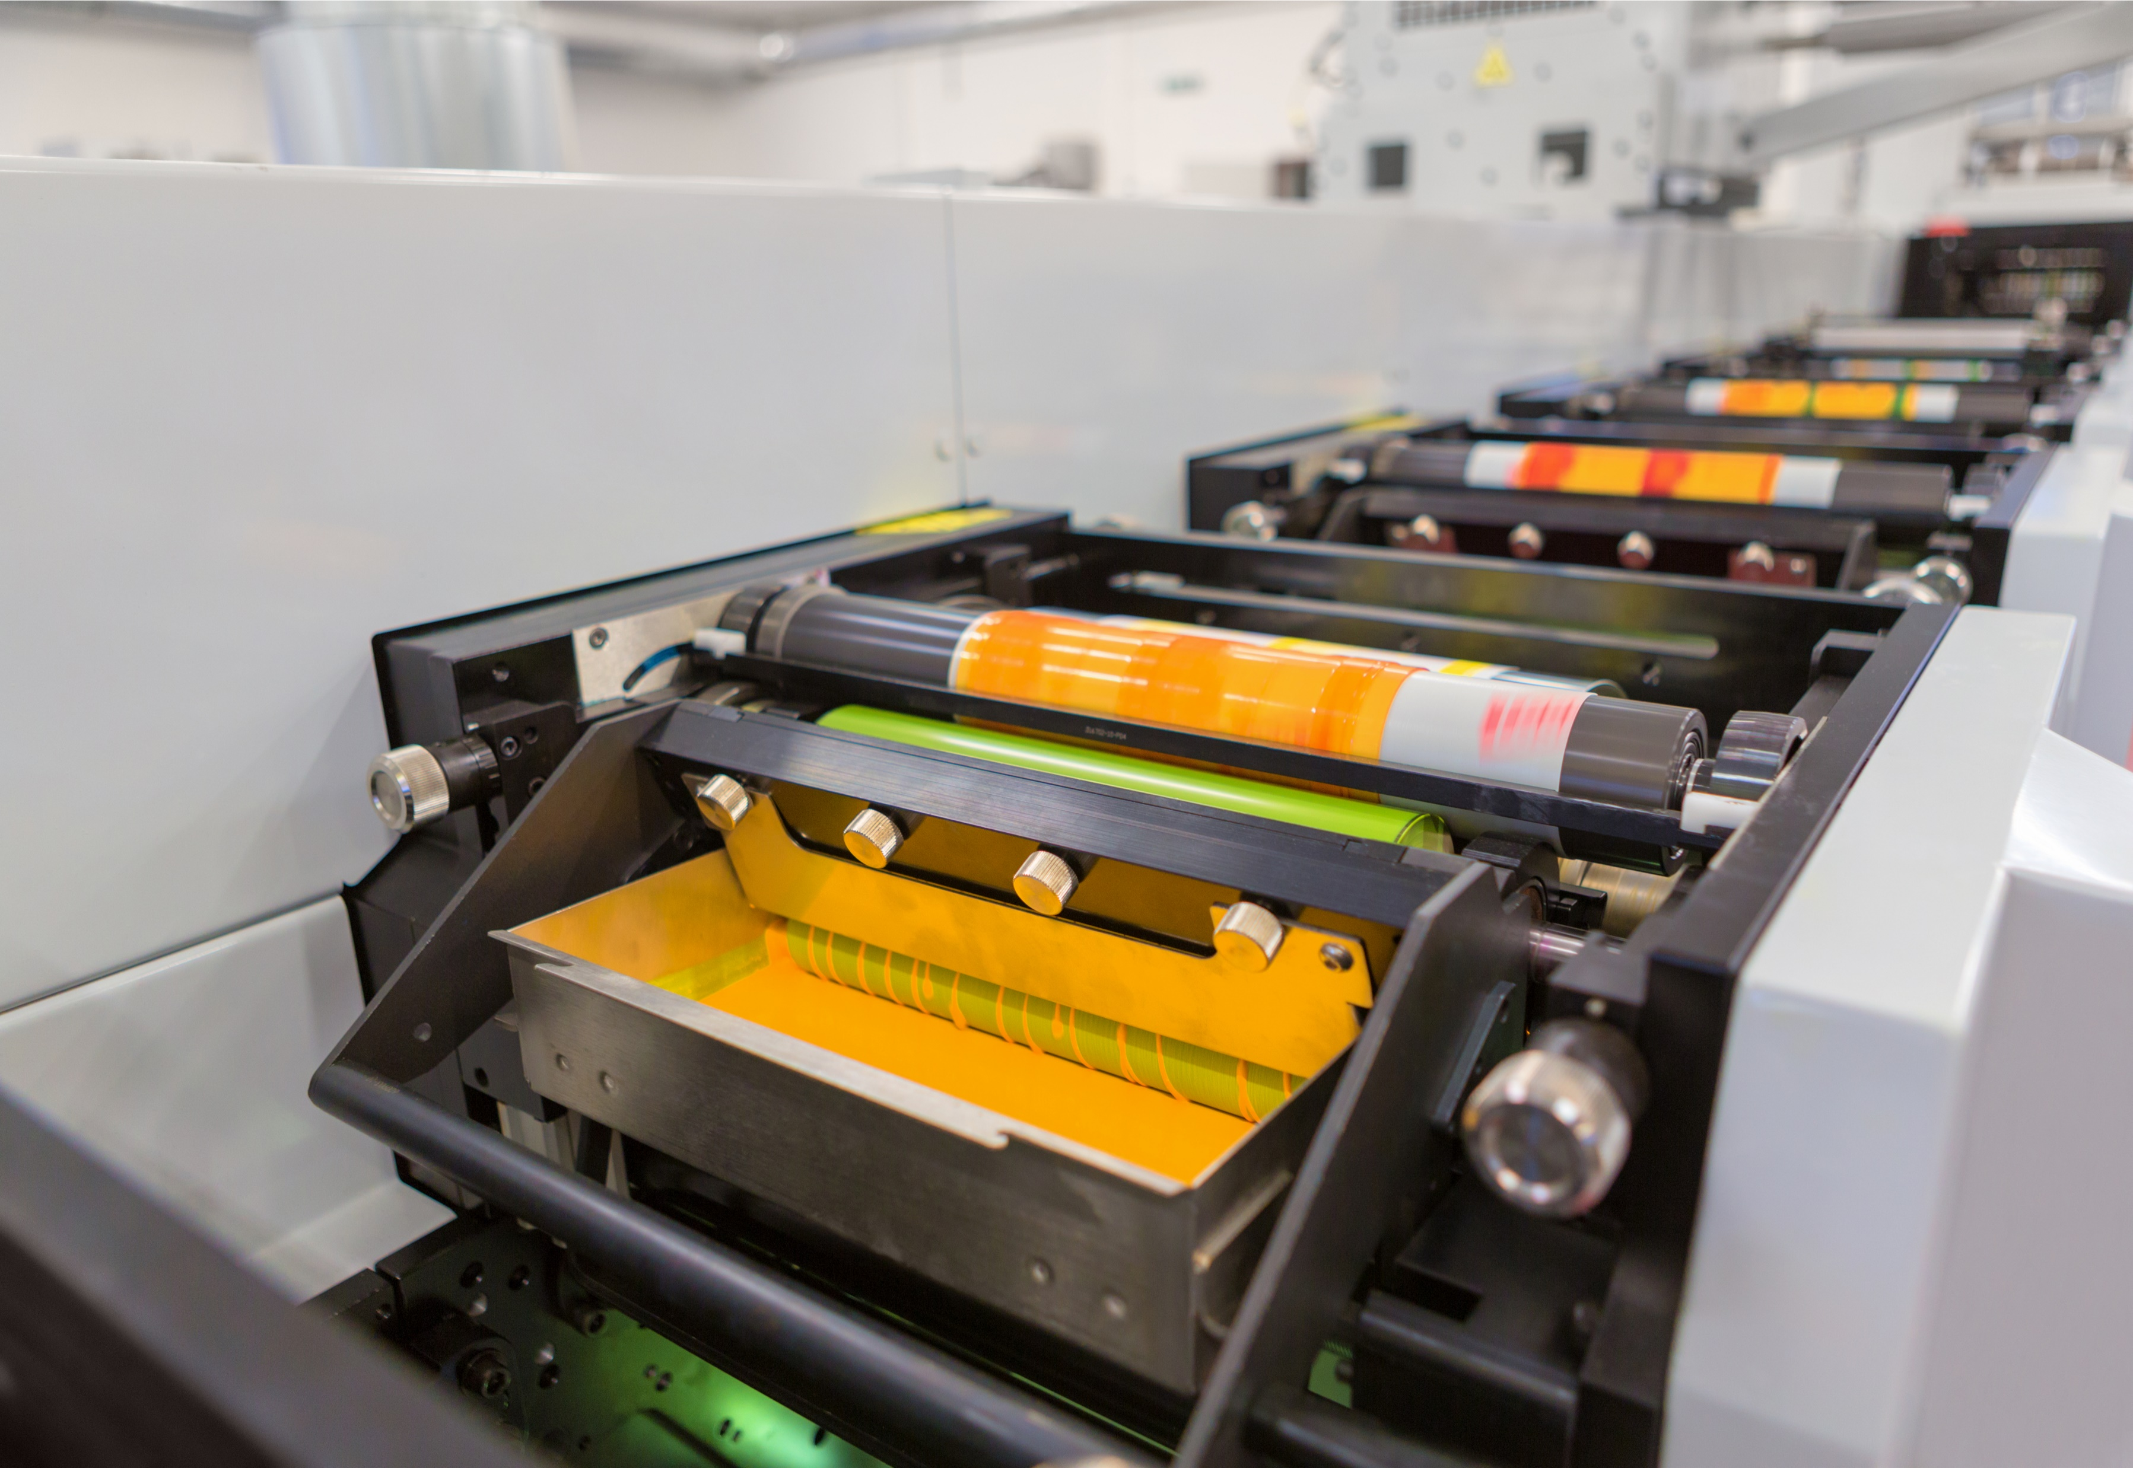
The benefits of Bellissima DMS
Reprographics benefits:
Printer benefits:
Brand owner benefits:
Ultra High-Definition (UHD) images
Smooth spot colors (up 7c)
Smooth fades to zero
No screen moiré
Exceptional shadow depth and details
1.2% printed highlight dot NW
1.8% printed highlight dot WW
Sharper reverse / tinted text at low point sizes
Faster make-ready
Easy on press
Uses less ink*
Reduces waste
Enables fixed palette (ECG)
Minimal training required
Makes use of existing equipment
Long runs possible: 2.5 million linear meters WW run length on 1 set of plates!
Cross market consistency
Ultra HD images
On-shelf ‘WOW’ factor
Eye-catching promo print
Anti-counterfeiting print
Low cost flexo vs. offset and gravure
* Independent laboratory tests: 13% & 16% savings on 20% & 40% flat tints (over and above any savings from GCR).

Slide 7
Conventional Flexo vs Bellissima Flexo
Ultra HD flexo
Photos courtesy of Carl Ostermann Erben

Slide 8
Conventional Flexo vs Bellissima Flexo
Smooth print results
Photos courtesy of Carl Ostermann Erben

Slide 9
Conventional Flexo vs Bellissima Flexo
No misregistration problems
Photos courtesy of Carl Ostermann Erben

Slide 10
Conventional Flexo vs Bellissima Flexo
7 color prints
Photos courtesy of Carl Ostermann Erben

Slide 11
Conventional Flexo vs Bellissima Flexo
Moiré-free
Photos courtesy of Carl Ostermann Erben

Slide 12
Conventional Flexo vs Bellissima Flexo
Fine elements and smooth gradients
Photos courtesy of Carl Ostermann Erben

Slide 13
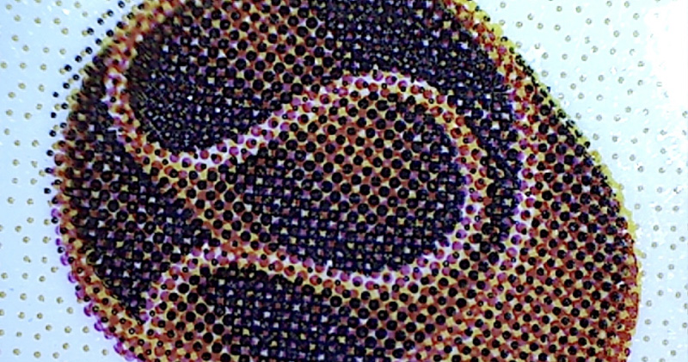
Conventional
Bellissima DMS

Slide 14
Flexo 133 lpi
Bellissima DMS

Slide 15
Bellissima DMS vs Offset 200 lpi
Offset 200 lpi
Bellissima DMS

Slide 16
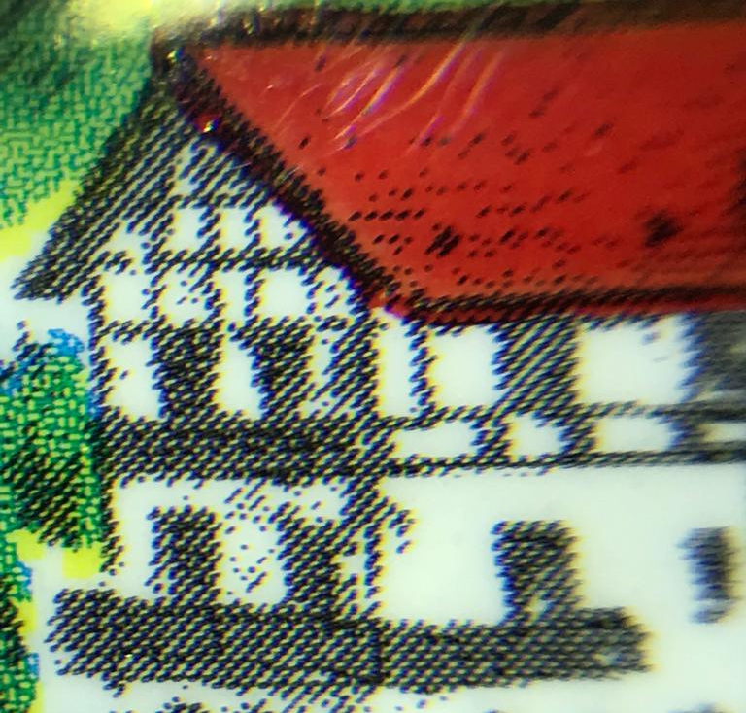
Bellissima: Replace Gravure with Flexo
Print Method: Flexo with Bellissima DMS
Print Method: Gravure

Slide 17
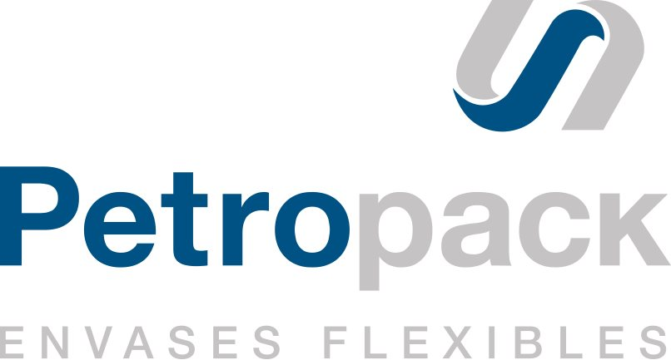
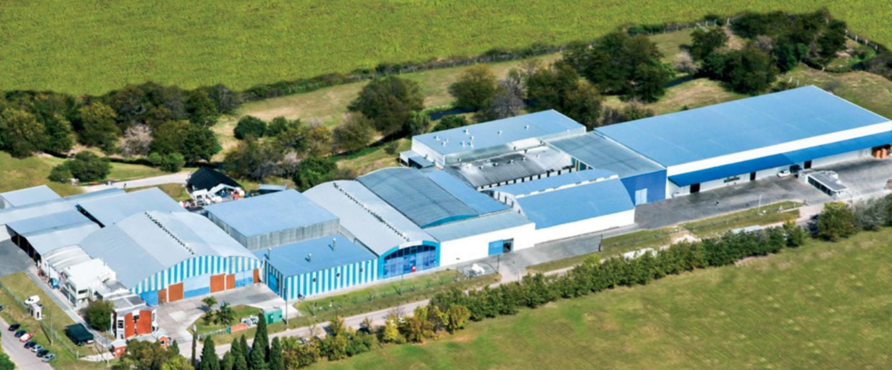
PETROPACK, Argentina
Expand Business: Replace Gravure with Flexo
Family business Founded in 1986 > 500 employees 200.000 m2 of facilities Located in City of Paraná, Argentina
EQUIPMENT: Plate: MacDermid ITP60 Screen: Hamillroad Bellissima DMS Repro: Fotograbados Lynch Press: Comexi F2 Flexo (8 colors) Comexi F4 Flexo (8 colors)

Slide 18
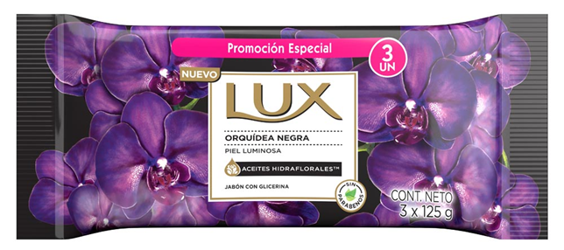
Expand Business: Replace Gravure with Flexo
Notes:
It was a print job converted from rotogravure to flexo thanks to the improvement in the fine details. Unilever Lux - Brand owner signed to convert more jobs to Flexo.
The person who has given to me this information is Gustavo Rebaque, production.

Slide 19
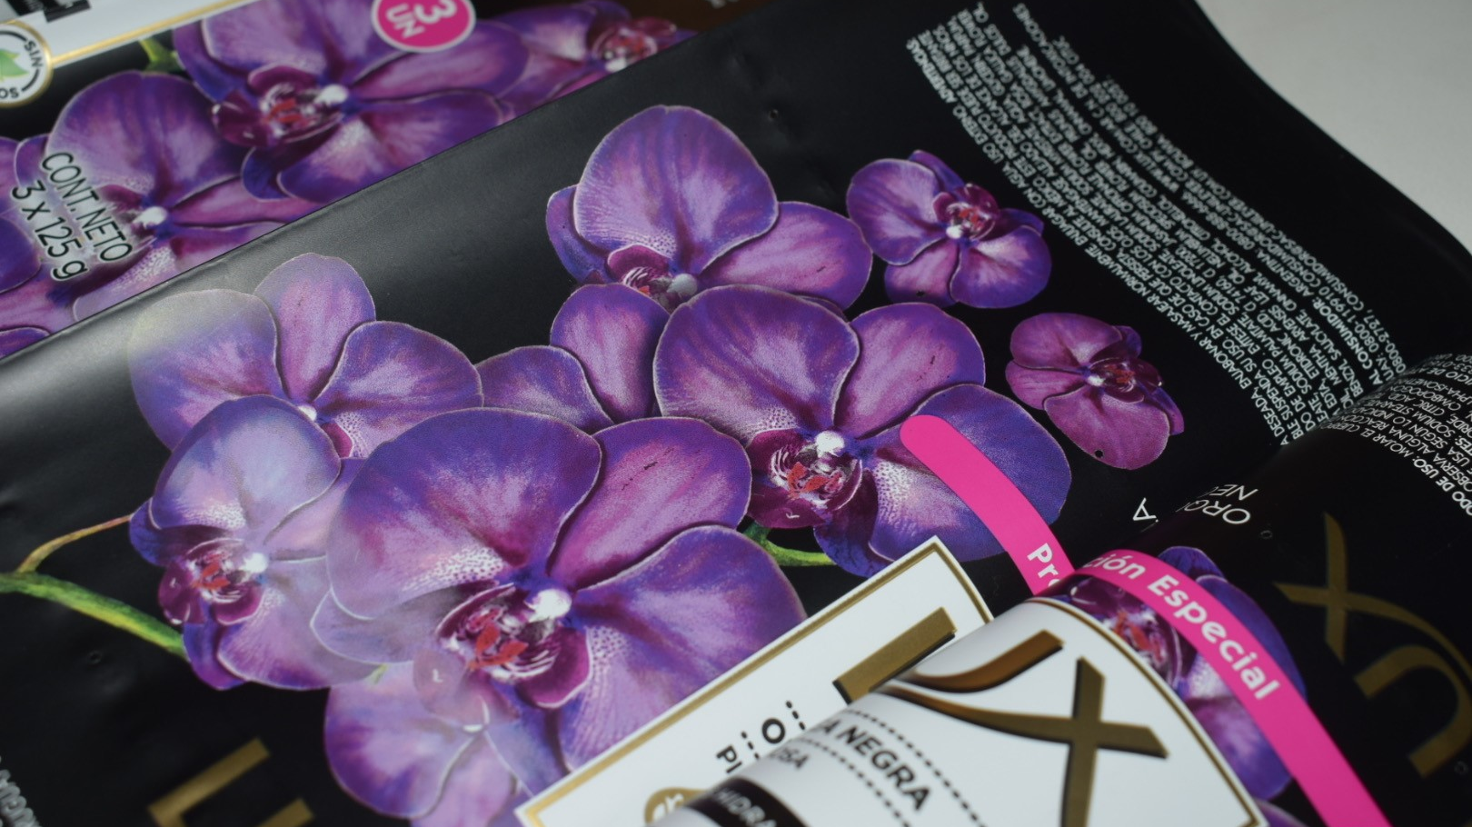

Slide 20
Enabling Lowest Cost Flexo
CHALLENGES:
Fidelity / high LPI printing challenges
Color shifts
Poor fades to zero
Angles / moiré, etc.
Flexo specific repro
CURRENT
STAGE 1
STAGE 2
AM-BASED SCREENS
BELLISSIMA
CMYK
BELLISSIMA
ECG
BENEFITS:
Faster deliveries
Huge cost reductions:
Capex: capacity +40%
Larger ink savings
Minimal wash-up req.
Reduced ink store
Reduced waste
Greener: reduced Ink
BENEFITS:
Gravure quality
Reduced costs:
Ink & waste
Stable color
Easy on press
Easier repro

Slide 21
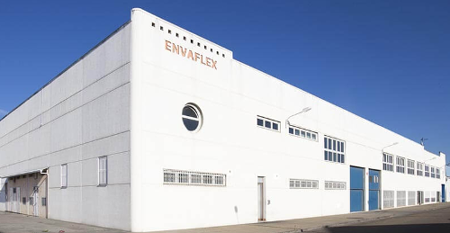
ENVAFLEX, Spain
Maximise Press Utilization
Family business Founded in 1984 > 100 employees 16.000 m2 of facilities Located in Zaragoza, Spain
EQUIPMENT: Plate: MacDermid ITP60 Screen: Hamillroad Bellissima DMS Repro: Flexographic Solutions S.L. Press: Comexi F2 Flexo

Slide 22
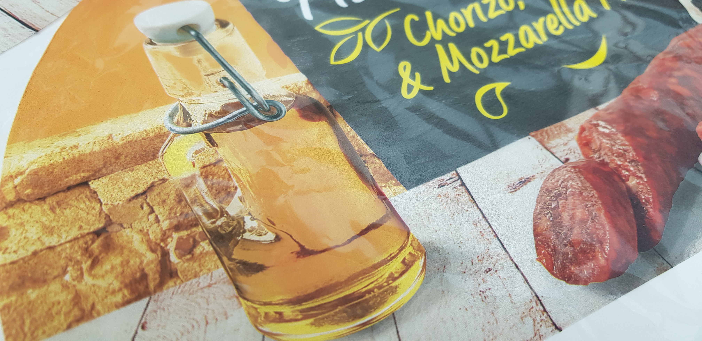
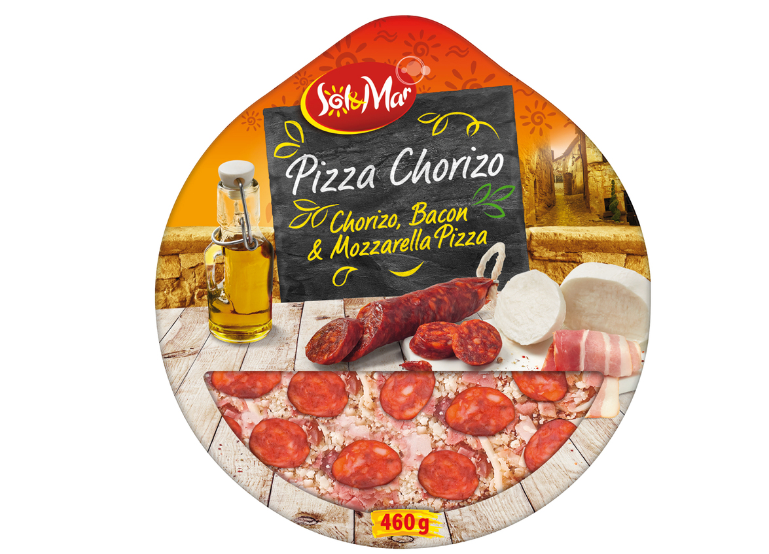
Maximise Press Utilization

Slide 23
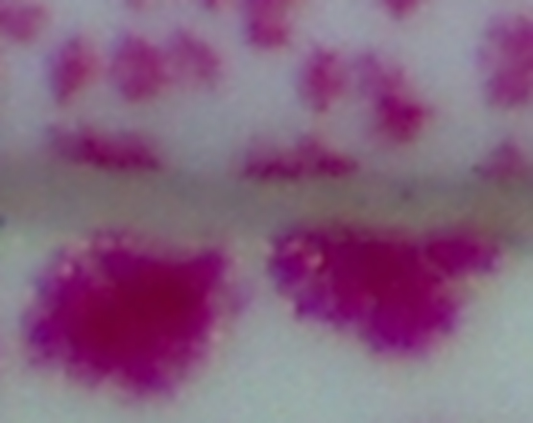
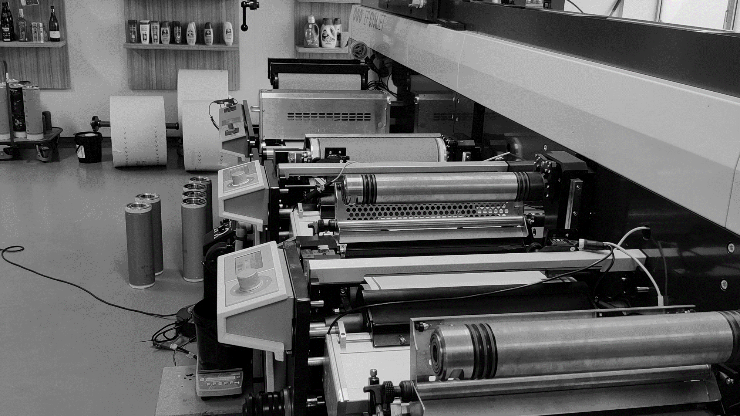
Ink Savings
AM vs DM

Slide 24
Historic Ink Savings with Bellissima
13% 20% flat tint vs Kodak NX
16% 40% flat tint vs Kodak NX
4.5 - 7.5%*
*(measured ink savings on real-world jobs vs AM screening at 2 customers)

Slide 25
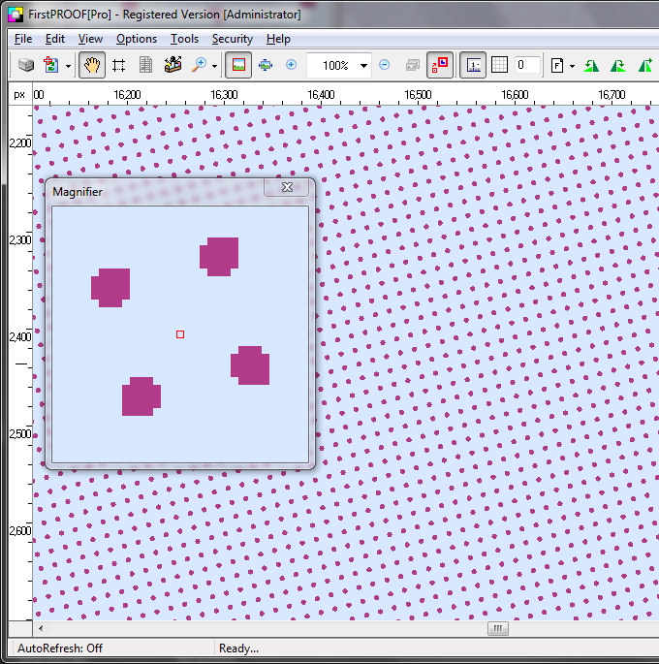
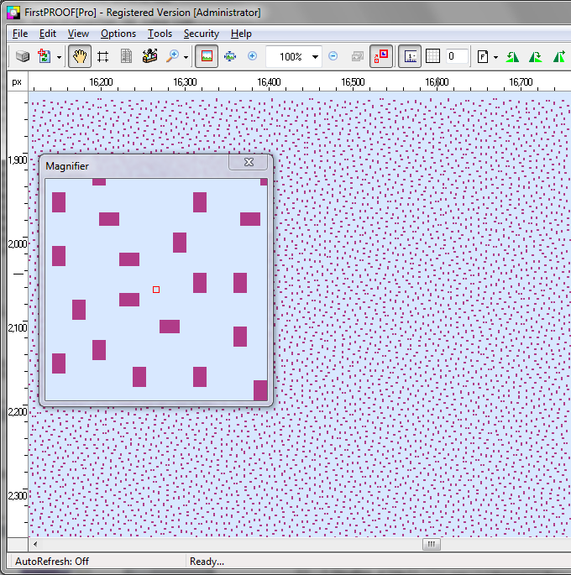
Bellissima: The Theory of Ink Savings
10% tint
AM screening
DM screening
Ink volume AM
Ink volume DM
Uses large dots
Uses smaller dots
Thicker ink film in centre of dot
Thinner, more even
ink film thickness

Slide 26
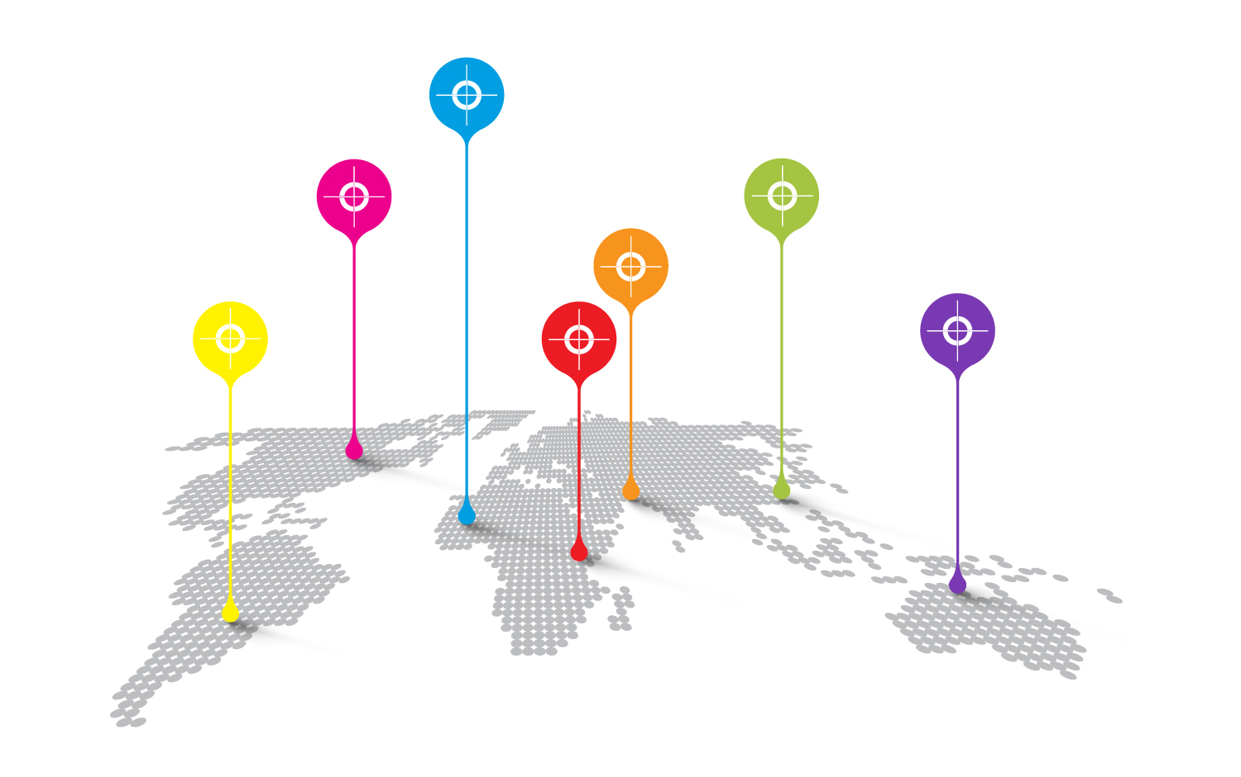
The Bellissima Network
The Bellissima Network provides a window on the members of the global Bellissima Trade Shop and Converters community.
Brands and printers can easily identify companies that can provide them with Bellissima plates and printing services.

Slide 27
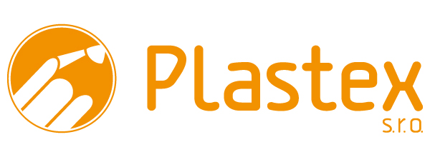
Network Members
Canada
Slovakia
Slovenia
USA
Indonesia
Brazil
France
China
Italy
India
USA
USA
Australia
Argentina
USA
USA
Spain
Germany
Mexico

Slide 28
Bellissima DMS
Questions

